Slide 1
Introduction
Tech Frontiers
David Quigley

Slide 2

About Me
Dr. David Quigley (You can call me David or Dr. Quigley)
Instructor, Dept. of Computer Science
Applied Machine Learning Research:
Studying the way students use digital tools in the classroom
- Student Scientific Modeling
- Student Learning from Texts
- Student Beliefs and Engagement with Scientific Inquiry

Slide 3
Class Resources
Computing Device
- Laptop recommended, any OS (ish)
Python 3 (with external packages)
- Anaconda recommended https://www.anaconda.com/download/

Slide 4
What is Machine Learning (ML)?
Advanced AI – rather than code results based on input, the machine makes its own decisions based on input
Finding patterns or categories in data, using those to predict categories in unseen data
Subproblems: deep learning, reinforcement learning
Modeling – large datasets to construct models

Slide 5
What is ML? Through History…
Arthur Samuel (1959) - Machine Learning: Field of study that gives computers the ability to learn without being explicitly programmed.
Notes:
https://en.wikipedia.org/wiki/Arthur_Samuel
https://www.ibm.com/developerworks/community/blogs/jfp/entry/What_Is_Machine_Learning?lang=en

Slide 6
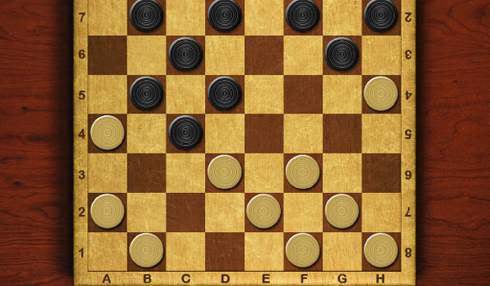
Notes:
https://www.coolmathgames.com/sites/cmatgame/files/checkers.jpg

Slide 7
What is ML? Through History…
Well-Posed Learning Problem (Tom Mitchell, 1998) - A computer program is said to learn from experience E with respect to some class of tasks T and performance measure P, if its performance at tasks in T, as measured by P, improves with experience E.
Notes:
https://www.cs.ubbcluj.ro/~gabis/ml/ml-books/McGrawHill%20-%20Machine%20Learning%20-Tom%20Mitchell.pdf

Slide 8

What is “Experience”?

Slide 9

What is “Experience”?
Notes:
http://rejoiner.com/resources/wp-content/uploads/2016/06/reco-based-purchase.png
https://imagescdn.tweaktown.com/news/3/7/37841_6_netflix_eyes_new_navigation_scheme_for_the_future.jpg
http://www.sciepub.com/images/22.png

Slide 10
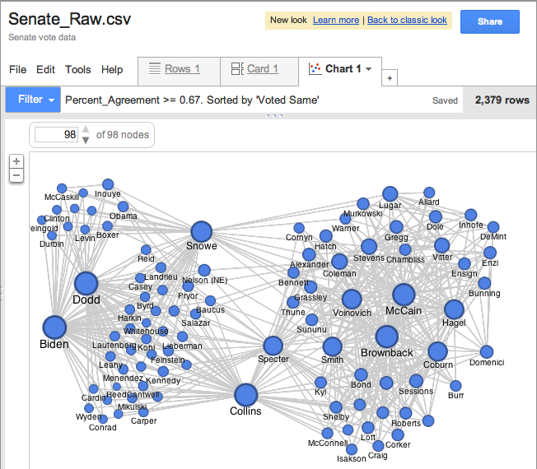
What is “Experience”?
Notes:
https://storage.googleapis.com/support-kms-prod/SNP_2754043_en_v0

Slide 11

What is “Experience”?
Notes:
http://rejoiner.com/resources/wp-content/uploads/2016/06/reco-based-purchase.png
https://imagescdn.tweaktown.com/news/3/7/37841_6_netflix_eyes_new_navigation_scheme_for_the_future.jpg
https://storage.googleapis.com/support-kms-prod/SNP_2754043_en_v0 http://www.sciepub.com/images/22.png

Slide 12
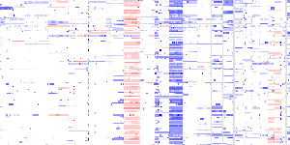
What is “Experience”?
Notes:
http://rejoiner.com/resources/wp-content/uploads/2016/06/reco-based-purchase.png
https://imagescdn.tweaktown.com/news/3/7/37841_6_netflix_eyes_new_navigation_scheme_for_the_future.jpg
https://storage.googleapis.com/support-kms-prod/SNP_2754043_en_v0 http://www.sciepub.com/images/22.png
https://www.broadinstitute.org/files/news/stories/full/IGV.jpg

Slide 13
What is ML? Through History…
Well-Posed Learning Problem (Tom Mitchell, 1998) - A computer program is said to learn from experience E with respect to some class of tasks T and performance measure P, if its performance at tasks in T, as measured by P, improves with experience E.
Notes:
https://www.cs.ubbcluj.ro/~gabis/ml/ml-books/McGrawHill%20-%20Machine%20Learning%20-Tom%20Mitchell.pdf

Slide 14

What is “Task”?
Notes:
https://www.popsci.com/sites/popsci.com/files/styles/1000_1x_/public/import/2013/images/2013/01/redditpage.png?itok=QYzbZlH7

Slide 15

What is “Task”?
Notes:
https://www.popsci.com/sites/popsci.com/files/styles/1000_1x_/public/import/2013/images/2013/01/redditpage.png?itok=QYzbZlH7
https://c.o0bg.com/rf/image_960w/Boston/2011-2020/2015/06/02/BostonGlobe.com/Magazine/Images/shutterstock_15484942-1837.jpg

Slide 16

What is “Task”?
Notes:
https://www.popsci.com/sites/popsci.com/files/styles/1000_1x_/public/import/2013/images/2013/01/redditpage.png?itok=QYzbZlH7
https://c.o0bg.com/rf/image_960w/Boston/2011-2020/2015/06/02/BostonGlobe.com/Magazine/Images/shutterstock_15484942-1837.jpg
http://gimmeinfo.com/wp-content/uploads/2016/02/pets-cat-dog-2-1100x866.jpg

Slide 17
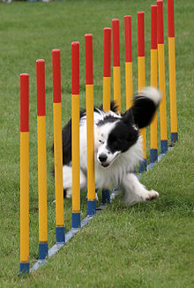
What is “Task”?
Notes:
https://www.popsci.com/sites/popsci.com/files/styles/1000_1x_/public/import/2013/images/2013/01/redditpage.png?itok=QYzbZlH7
https://c.o0bg.com/rf/image_960w/Boston/2011-2020/2015/06/02/BostonGlobe.com/Magazine/Images/shutterstock_15484942-1837.jpg
http://gimmeinfo.com/wp-content/uploads/2016/02/pets-cat-dog-2-1100x866.jpg
https://upload.wikimedia.org/wikipedia/commons/thumb/d/d2/Border_collie_weave_poles.jpg/220px-Border_collie_weave_poles.jpg

Slide 18

What is “Task”?
Notes:
https://www.popsci.com/sites/popsci.com/files/styles/1000_1x_/public/import/2013/images/2013/01/redditpage.png?itok=QYzbZlH7
https://c.o0bg.com/rf/image_960w/Boston/2011-2020/2015/06/02/BostonGlobe.com/Magazine/Images/shutterstock_15484942-1837.jpg
http://gimmeinfo.com/wp-content/uploads/2016/02/pets-cat-dog-2-1100x866.jpg
https://upload.wikimedia.org/wikipedia/commons/thumb/d/d2/Border_collie_weave_poles.jpg/220px-Border_collie_weave_poles.jpg
https://d38kx05og7618t.cloudfront.net/uploads/sites/4/2016/01/iStock_000024526236_Medium.jpg

Slide 19
What is ML? Through History…
Well-Posed Learning Problem (Tom Mitchell, 1998) - A computer program is said to learn from experience E with respect to some class of tasks T and performance measure P, if its performance at tasks in T, as measured by P, improves with experience E.
Notes:
https://www.cs.ubbcluj.ro/~gabis/ml/ml-books/McGrawHill%20-%20Machine%20Learning%20-Tom%20Mitchell.pdf

Slide 20
What is “[Improved] Performance”?

Slide 21
What is “[Improved] Performance”?

Slide 22
What is “[Improved] Performance”?
Notes:
https://mk0ehealthelets5xdjo.kinstacdn.com/wp-content/uploads/2017/12/MRI-scan-brain-tumour-300x249.jpg

Slide 23
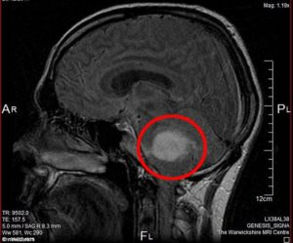
What is “[Improved] Performance”?

Slide 24
Machine Learning is Math
Data (X) → Hidden Relationship (Z) → Answer (Y)
X = (X₁, X₂, … X_{n}), each entry in X is a feature
Y is a response
Z is the algorithm that maps features to response

Slide 25
Machine Learning is Math
Data (X) → Hidden Relationship (Z) → Answer (Y)
X = (X₁, X₂, … X_{n}), each entry in X is a feature
Y is a response
Z is the algorithm that maps features to response
According to theory, there is a Z to map every X (of infinite size) to the real Y

Slide 26
Machine Learning is Math
Data (X) → Hidden Relationship (Z) → Answer (Y)
X = (X₁, X₂, … X_{n}), each entry in X is a feature
Y is a response
Z is the algorithm that maps features to response
According to theory, there is a Z to map every X (of infinite size) to the real Y
Machine Learning is an approximation of Z
(Sometimes we care about trying to discover / measure the true Z, sometimes not)

Slide 27
Problem Space – College Admissions
The following scenario isn’t really true, but it’s close-ish to what we do in college admissions…
I am trying to decide if a student should be admitted to my university. I have their SAT and ACT scores and their HS GPA. I also have the history of students who have attended in the past, their SAT / ACT / HS GPA as well as whether or not they graduated. I only want to admit new students if they will graduate.

Slide 28
Problem Space – College Admissions
X_{i} =
Y =

Slide 29
My First ML Algorithm – K-Nearest Neighbors
Classifying a new / unknown student x:
Given my training set D, find the K students that are “nearest” to x and assign x to the label y held by the majority of those students.
What does “nearest” mean?

Slide 30
Prediction – College Admission
Student | SAT | ACT | GPA | Graduated?
A | 1200 | 26 | 3.2 | Yes
B | 1450 | 28 | 3.5 | Yes
C | 1000 | 20 | 3.0 | Yes
D | 730 | 15 | 2.0 | No
NEW | 720 | 16 | 2.2 | ???

Slide 31
Prediction – College Admission
Student | X₁ | X₂ | Y
A | 1200 | 26 | 1
B | 1450 | 28 | 1
C | 1000 | 20 | 1
D | 730 | 15 | -1
NEW | 720 | 16 | ???

Slide 32
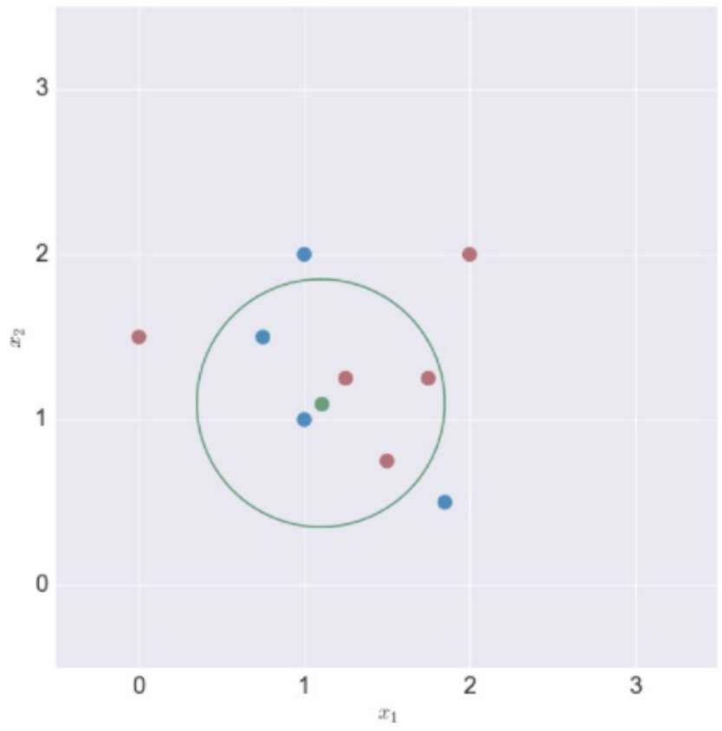
KNN – Euclidian Distance (L₂ Norm)
Euclidian Distance: ||x_{i} – x|| ²

Slide 33
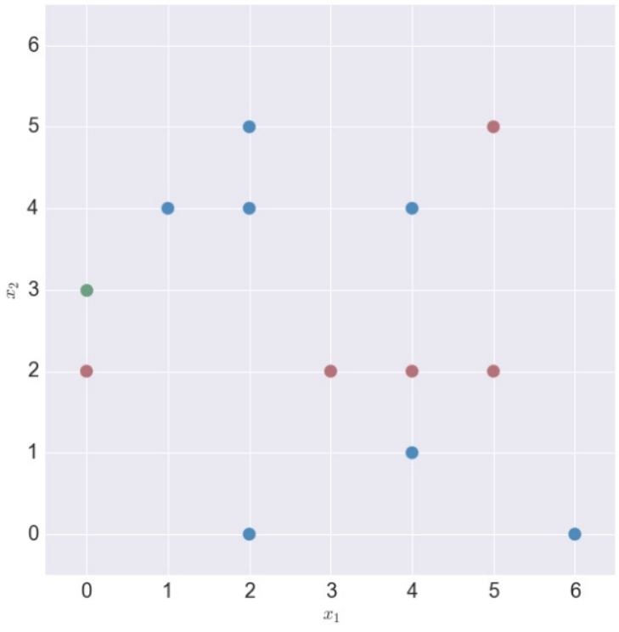
Find the Nearest Neighbors
K = 1, Point to classify at (0,3)
Nearest Neighbor
Prediction

Slide 34
Find the Nearest Neighbors
K = 2
Nearest Neighbors
Prediction

Slide 35
Find the Nearest Neighbors
K = 3
Nearest Neighbors
Prediction

Slide 36
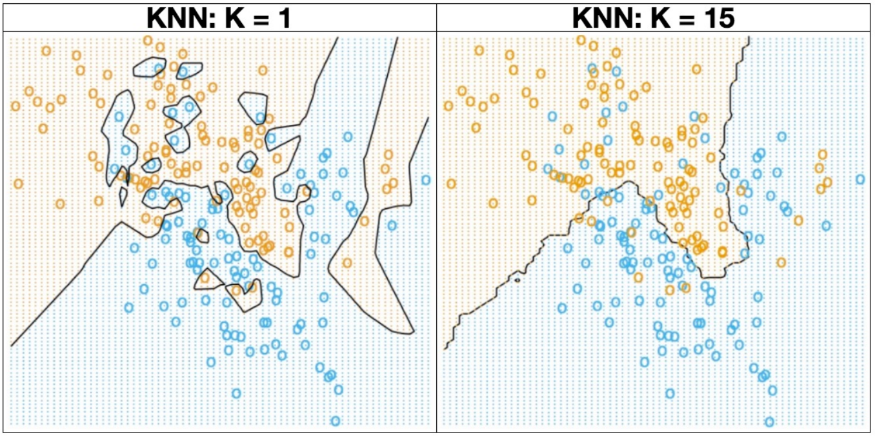
My First ML Algorithm – KNN

Slide 37
Prediction – College Admission
What are you going to predict for this NEW case with K = 1?
Student | X₁ | X₂ | Y
A | 1200 | 26 | 1
B | 1450 | 28 | 1
C | 1000 | 20 | 1
D | 730 | 15 | -1
NEW | 720 | 16 | ???

Slide 38
Prediction – College Admission
What are you going to predict for this NEW case with K = 1?
Student | X₁ | X₂ | Y
A | 1200 | 26 | 1
B | 1450 | 28 | 1
C | 1180 | 20 | 1
D | 730 | 15 | -1
NEW | 950 | 30 | ???

Slide 39
Normalization or Scaling
Transform X (Data) to X’ (Scaling Data)
For (x_{i}) in X
scale = max(x_{i}) – min(x_{i})
For (x_{i,j}) in (x_{i})
x’_{i,j} = (x_{i,j} – min(x_{i})) / scale

Slide 40
Scaling – College Prediction
Student | SAT | ACT | GPA | Graduated?
A | 1200 / 1600 | 26 / 36 | 3.2 / 4.0 | Yes
B | 1450 / 1600 | 28 / 36 | 3.5 / 4.0 | Yes
C | 1000 / 1600 | 20 / 36 | 3.0 / 4.0 | Yes
D | 730 / 1600 | 15 / 36 | 2.0 / 4.0 | No
NEW | 720 / 1600 | 16 / 36 | 2.2 / 4.0 | ???

Slide 41
Normalization and Scaling
Normalization is important for us to consider
- It will allow us to consider variables on equal footing
Normalization is important for us to consider on a case by case basis
- Sometimes a “default” transformation won’t make sense

Slide 42



KNN – Beyond Binary Decisions
Iris Classification
Iris Setosa
Iris Versicolor Iris Virginica
https://en.wikipedia.org/wiki/Iris_flower_data_set

Slide 43
KNN – Beyond Binary Decisions
What are some questions / issues / considerations you see arising in this problem space?
https://en.wikipedia.org/wiki/Iris_flower_data_set

Slide 44
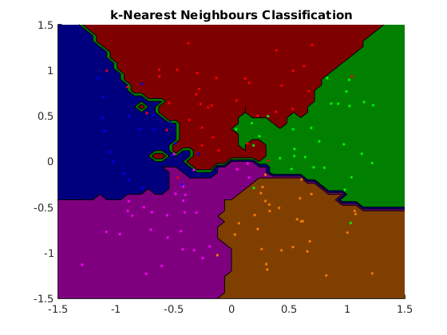
Multi-Class Classification - KNN
Notes:
https://www.cs.ubc.ca/~schmidtm/Software/matLearn/multiclass/demos/html/demo_multiclass_KNN_01.png

Slide 45
How do we know if it works?

Slide 46
Evaluating Models

Slide 47
How do we know if it works?

Slide 48
Find the Nearest Neighbors
Classification
Our objective – Predicting a class
Did we get it right?
How do we know we got it right?

Slide 49
How do we know if it works?
Classify ones we already know the answer to!

Slide 50
Training & Test Sets
Train a KNN on everything
K = 1
What does my nearest neighbor to X look like?
My Data

Slide 51
Training & Test Sets
Test Data
Divide it into training and testing sets!
Train Data

Slide 52
How do we know if it works?

Slide 53
Training & Test Sets
Test Data
I pull out the last 20% of samples
But what if they were put in order?
Train Data

Slide 54
How do we know if it works?

Slide 55
How do we know if it works?

Slide 56
Homework 1 – Training & Test Sets
Train Data
I pull out a random 20% of my data
Now I have something (probably) representative, AND
I’m not just testing inherent bias of my model
Test Data

Slide 57
K-Nearest Neighbors
PROS
Very simple, efficient algorithm
Works well for smaller data sets
Easy to try (just see if it works!)
CONS
Makes an assumption about x
Can inherit Bias

Slide 58
What is an Error?
We’ve looked at trying it out on a test set and getting an “accuracy”
Accuracy = # correct / # total
What is our “test set”?
Are all mistakes created equal?

Slide 59
Types of Errors
Classified As Ground Truth | C | ~C
C
~C

Slide 60
Types of Errors
Classified As Ground Truth | C | ~C
C | True Positive (Hit) | False Negative (Miss)
~C | False Positive (False Alarm) | True Negative (Correct Rejection)

Slide 61
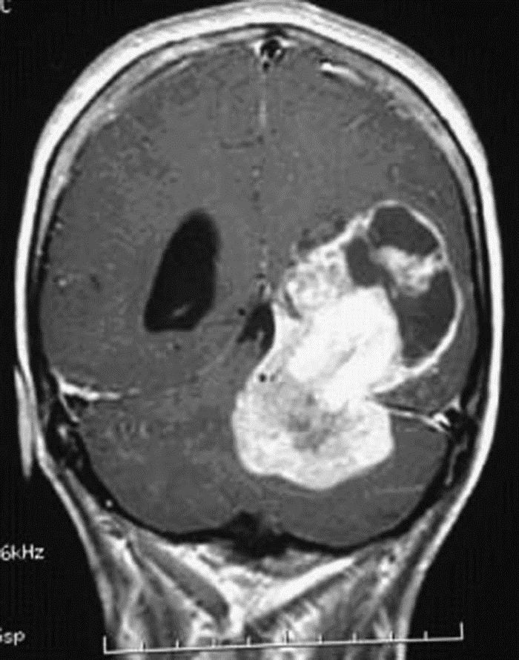
What makes an error?

Slide 62
Types of Errors
Classified As Ground Truth | Cancer | Not Cancer
Cancer | True Positive (Hit) | False Negative (Miss)
Not Cancer | False Positive (False Alarm) | True Negative (Correct Rejection)

Slide 63
Exercise 1 – K-Nearest Neighbors
Classifying our grid
Classifying Adult Income

Slide 64
Types of Errors
Classified As Ground Truth | C | ~C
C | True Positive (Hit) | False Negative (Miss)
~C | False Positive (False Alarm) | True Negative (Correct Rejection)

Slide 65
Calculating Errors
Error =# errors / # instances
Is this always helpful? Meaningful?

Slide 66
Errors
Skewed Classes
- In our Adult Income Dataset, ~76% of cases are < 50k income

Slide 67
Errors
Skewed Classes
- In our Adult Income Dataset, ~76% of cases are < 50k income
- Classifying a day of sun in Yuma, AZ (308 sunny days / year)
my classifier - isSunny = true

Slide 68
Errors
Skewed Classes
- In our Adult Income Dataset, ~76% of cases are < 50k income
- Classifying a day of sun in Yuma, AZ (308 sunny days / year)
my classifier - isSunny = true
84 % Accuracy
- What if it’s a case with 98% in one class?
Is 98.5% accuracy helpful?

Slide 69
Errors
Skewed Classes
- In our Adult Income Dataset, ~76% of cases are < 50k income
- Classifying a day of sun in Yuma, AZ (308 sunny days / year)
my classifier - isSunny = true
84 % Accuracy
- What if it’s a case with 98% in one class?
Is 98.5% accuracy helpful?
Are all errors created equal?

Slide 70
Are all errors created equal?
Truth – No Cancer Truth – Cancer
Classified Cancer Classified No Cancer

Slide 71
Are all errors created equal?
Truth – No Cancer Truth – Cancer
Classified Cancer Classified No Cancer
Goes to get a new Moves on with their
test – more expensive day. Does not
but more accurate. pursue treatments.
Discovers true status. Cancer worsens.

Slide 72
Probability

Slide 73
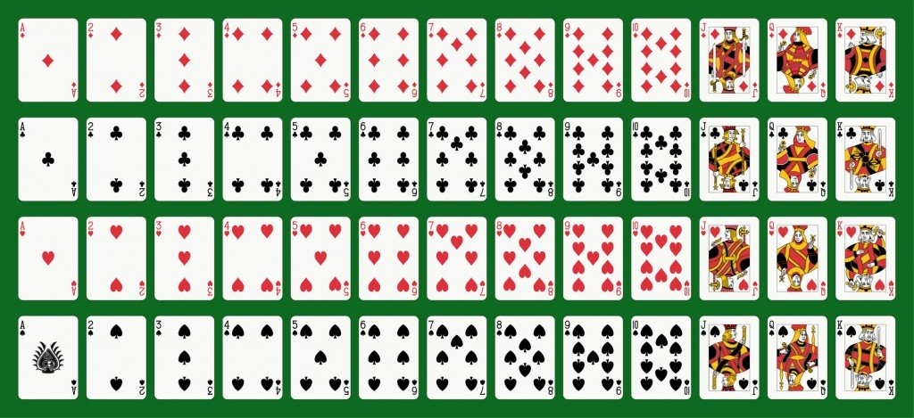
Probability Refresher
52 Cards
2 Colors {Red, Black}
4 Suits {D,C,H,S}
13 Values {A,2,3,…K}
Notes:
https://www.scienceabc.com/wp-content/uploads/2016/05/Fotolia_23299310_Subscription_Monthly_M.jpg

Slide 74
Probability Refresher
V – Random variable of Value
v = “ace”, v = 7, etc.
p(v) = probability that card has value “v”
C – Random variable of Color
C = Red or C = Black
p(c) = probability that card has color “c”
Joint probability – probability of multiple events simultaneously
p(v,c) = probability that card has value “v” and color “c”
probability of a Red 7 can be written as p(v=7,c=red) or p(7,red)

Slide 75
Probability Refresher – Product Rule
Product rule: p(A,B) = p(A|B)*p(B) = p(B|A)*p(A)
The Joint probability is equal to to the conditional probability multiplied by the probability of the condition (the marginal probability).
p(C,V) = p(C|V)*p(V) = p(V|C)*p(C)
P(Red,7) =
p(Red) =
P(7) =
p(Red,7) =

Slide 76
Probability Refresher – Chain Rule
For three variables, A,B,C, we can use the Product Rule repeatedly to show:
p(A,B,C) = p(a) * p(b|a) * p(c|b,a)
For i random variables X_{1:I}, we have:
p(X_{1:i}) = p(X₁) * p(X₂|X₁) * … * p(X_{i}|X_{1:i-1})
Proving the Chain Rule is left as an exercise for the interested student

Slide 77
Probability Refresher – Sum Rule
Conversely, if we know the joint probabilities, we can compute the marginal.
p(A) = ∑_{b}p(A,B=b) = ∑_{b}p(A|B=b) * p(B=b)
Given p(C=Red,V=7) and p(C=Black,V=7), calculate p(V=7)

Slide 78
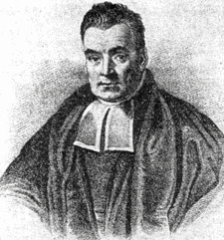
Naïve Bayes

Slide 79
Probabilistic Classification
D = {(X_{i},Y_{i})}_{i=1→n}
x_{i} ∈ ℝ (i.e. each feature value is a Real number)
y ∈ {c₁,c₂,…c_{j}} (i.e. Y is a “class”)
Given a new x, estimate a new y
For each y = c_{j} we can measure p(y = c_{j} | x, D)
Assign y = argmax_{c} p(y = c | x, D)

Slide 80
Probability – Bayes Rule
p(A,B) = p(A|B)*p(B) = p(B|A)*p(A)
p(X,Y) = p(Y|X)*p(X) → p(Y|X)* = p(X,Y) / p(X) $→ p(Y|X) = (p(X|Y)*p(Y)) / p(X)
p(Y|X) = p(X|Y)*p(Y)
p(X)
$ = assuming p(X) > 0 (i.e. our data is possible)

Slide 81
Probability – Bayes Rule + Sum Rule
If we evaluate the
p(Y = y|X = x) = p(X = x | Y = y)*p(Y = y)
p(X = x)
And we use the sum rule…
p(Y = y|X = x) = p(X = x | Y = y)*p(Y = y)
∑_{y’}p(X=x|Y=y’) * p(Y=y’)
We can compute p(y|x) from nothing but p(x|y) and p(y)

Slide 82
Naïve Bayes Classification
We want to model the joint probability: p(x,y)
What we actually care about is the probability of our answer given the data: p(y|x)
p(Y|X) = p(X|Y)*p(Y)
p(X)
Or…
Posterior probability = class-conditional * prior
evidence

Slide 83
Naïve Bayes Classification
“What is the possibility that an example is of class c given its observed features?”
- What is the probability it is a grad (pos) given its HS outcomes?
Given a HS x:
If p(pos | x) >= p(neg | x)
classify as pos
Else
classify as neg

Slide 84
Naïve Bayes
PROS
Very simple, efficient algorithm
Works well for smaller data sets
Easy to try (just see if it works!)
CONS
Makes an assumption about x
Can inherit Bias

Slide 85
Class-conditional probability p(X | Y)
i.e. “Likelihood”
“Given (or assuming) y = c, what is the probability x is observed?”
“Given my assumptions about failing students, what’s the probability that I see this particular student?”
p(x = [GPA=1.2,SAT=550] | y = neg)
NOTE: Now we’re assuming joint probability of features

Slide 86
Naïve Bayes – Assumption of Independence
Features of x are conditionally independent for a given class y.

Slide 87
Naïve Bayes – Assumption of Independence
Features of x are conditionally independent for a given class y.
Take two weighted coins, C₁ and C₂.

Slide 88
Naïve Bayes – Assumption of Independence
Features of x are conditionally independent for a given class y.
Take two weighted coins, C₁ and C₂.
Pick a coin and flip it 3 times. Which coin did we flip?
p(x=[HHT] | C₁) = p(H|C₁) * p(H|C₁) * p(T|C₁)
Vs
p(x=[HHT] | C₂) = p(H|C₂) * p(H|C₂) * p(T|C₂)

Slide 89
Naïve Bayes – Assumption of Independence
Features of x are conditionally independent for a given class y.
Take two weighted coins, C₁ and C₂.
Pick a coin and flip it 3 times. Which coin did we flip?
p(x=[HHT] | C₁) = p(H|C₁) * p(H|C₁) * p(T|C₁)
Vs
p(x=[HHT] | C₂) = p(H|C₂) * p(H|C₂) * p(T|C₂)
Draw 3 cards from a deck of cards, one at a time (no replacement). Does this still hold?

Slide 90
Naïve Bayes – Assumption of Independence
Features of x are conditionally independent for a given class y.
p(x=[GPA=1.2,SAT=550,ACT=21] | neg) = p(GPA=1.2 | neg) * p(SAT=550| neg) * p(ACT=21 | neg)
Is this valid?
Probably not, but a) we’ll make the assumptions for both pos and neg, and b) it makes feature conditionals easy to estimate

Slide 91
Naïve Bayes – Class-Conditional Probability
Features of x are conditionally independent for a given class y.
p(x=[GPA=1.2,SAT=550,ACT=12] | neg) = p(GPA=1.2| neg) * p(SAT=550| neg) * p(ACT=21 | neg)
How do we calculate the class-conditional probability?
Estimate from Data!
P(GPA=1.2| neg) = # failing students with a HS GPA of 1.2
# failing students

Slide 92
Naïve Bayes Classification
We want to model the joint probability: p(x,y)
What we actually care about is the probability of our answer given the data: p(y|x)
p(Y|X) = p(X|Y)*p(Y)
p(X)
Or…
Posterior probability = class-conditional * prior
evidence

Slide 93
Prior Probability p(y)
“What is the probability of encountering class c?”
p(neg) = “What is the probability that any given student will fail?”
How do we get this information?

Slide 94
Prior Probability p(y)
“What is the probability of encountering class c?”
p(neg) = “What is the probability that any given student will fail?”
How do we get this information?
Ask Someone Who Knows!
Assume 80% of students fail
this class assumption does not necessarily match the real world!

Slide 95
Prior Probability p(y)
“What is the probability of encountering class c?”
p(neg) = “What is the probability that any given student will fail?”
How do we get this information?
Estimate it from Data!
P(neg) = # failing students
# students

Slide 96
Naïve Bayes Classification
We want to model the joint probability: p(x,y)
What we actually care about is the probability of our answer given the data: p(y|x)
p(Y|X) = p(X|Y)*p(Y)
p(X)
Or…
Posterior probability = class-conditional * prior
evidence

Slide 97
Evidence p(x)
“The probability of encountering x independent of class”
“the probability of getting that exact HS outcome”
We could estimate this using the sum rule…

Slide 98
Naïve Bayes Classification
“What is the possibility that an example is of class c given its observed features?”
- What is the probability it is a positive grad given its HS features ?
Given HS features x:
If p(pos | x) >= p(neg | x)
classify as pos
Else
classify as neg

Slide 99
Evidence p(x)
“The probability of encountering x independent of class”
“the probability of getting that exact message”
We could estimate this using the sum rule…
But it doesn’t actually matter in our decision making process
p(x | pos) * p(pos) >=<? p(x | neg) * p(neg)
p(x) p(x)

Slide 100
Evidence p(x)
“The probability of encountering x independent of class”
“the probability of getting that exact message”
We could estimate this using the sum rule…
But it doesn’t actually matter in our decision making process
p(x | pos) * p(pos) >=<? p(x | neg) * p(neg)
It’s not really probability anymore, but we have scores for each condition…

Slide 101
Naïve Bayes Classification - Example
 | Pos | Neg | Neg | Neg | Pos
GPA | 2.5 | 1.9 | 1.2 | 2.1 | 4.0
SAT | 1100 | 990 | 750 | 1100 | 1600
ACT | 21 | 16 | 16 | 21 | 36

Slide 102
Naïve Bayes Classification - Example
If I get a new student with [GPA = 1.2, SAT = 550, ACT = 21], do we expect them to graduate (pos) or not (neg)?
 | Pos | Neg | Neg | Neg | Pos
GPA | 2.5 | 1.9 | 1.2 | 2.1 | 4.0
SAT | 1100 | 990 | 750 | 1100 | 1600
ACT | 21 | 12 | 16 | 21 | 36

Slide 103
Naïve Bayes Classification - Example
If I get a new student with [GPA = 1.2, SAT = 550, ACT = 21], do we expect them to graduate (pos) or not (neg)?
 | Pos | Neg | Neg | Neg | Pos | ???
GPA | 2.5 | 1.9 | 1.2 | 2.1 | 4.0 | 1.2
SAT | 1100 | 990 | 750 | 1100 | 1600 | 550
ACT | 21 | 12 | 16 | 21 | 36 | 21

Slide 104
Naïve Bayes Classification - Example
If I get a new student with [GPA = 1.2, SAT = 550, ACT = 21], do we expect them to graduate (pos) or not (neg)?
p(pos | 1.2, 550, 21) >=<? p(neg | 1.2,550,21)
 | Pos | Neg | Neg | Neg | Pos | ???
GPA | 2.5 | 1.9 | 1.2 | 2.1 | 4.0 | 1.2
SAT | 1100 | 990 | 750 | 1100 | 1600 | 550
ACT | 21 | 12 | 16 | 21 | 36 | 21

Slide 105
Naïve Bayes Classification - Example
If I get a new student with [GPA = 1.2, SAT = 550, ACT = 21], do we expect them to graduate (pos) or not (neg)?
p(pos | 1.2, 550, 21) = ???
 | Pos | Neg | Neg | Neg | Pos | ???
GPA | 2.5 | 1.9 | 1.2 | 2.1 | 4.0 | 1.2
SAT | 1100 | 990 | 750 | 1100 | 1600 | 550
ACT | 21 | 12 | 16 | 21 | 36 | 21

Slide 106
Naïve Bayes Classification - Example
If I get a new student with [GPA = 1.2, SAT = 550, ACT = 21], do we expect them to graduate (pos) or not (neg)?
PRODUCT RULE
p(pos | 1.2, 550, 21) = p(1.2, 550, 21 | pos) * p(pos)
 | Pos | Neg | Neg | Neg | Pos | ???
GPA | 2.5 | 1.9 | 1.2 | 2.1 | 4.0 | 1.2
SAT | 1100 | 990 | 750 | 1100 | 1600 | 550
ACT | 21 | 12 | 16 | 21 | 36 | 21

Slide 107
Naïve Bayes Classification - Example
If I get a new student with [GPA = 1.2, SAT = 550, ACT = 21], do we expect them to graduate (pos) or not (neg)?
ASSUME INDEPENDENCE
p(pos | 1.2, 550, 21) = p(1.2 | pos) * p(550 | pos) * p(21 | pos) * p(pos)
 | Pos | Neg | Neg | Neg | Pos | ???
GPA | 2.5 | 1.9 | 1.2 | 2.1 | 4.0 | 1.2
SAT | 1100 | 990 | 750 | 1100 | 1600 | 550
ACT | 21 | 12 | 16 | 21 | 36 | 21

Slide 108
Overcoming Data Problems
We’ve never seen a student with an SAT of 550 before! How might you address this?
 | Pos | Neg | Neg | Neg | Pos | ???
GPA | 2.5 | 1.9 | 1.2 | 2.1 | 4.0 | 1.2
SAT | 1100 | 990 | 750 | 1100 | 1600 | 550
ACT | 21 | 12 | 16 | 21 | 36 | 21

Slide 109
Overfitting Solutions - Binning
Binning – Assign values to bins
Bins can vary in size, number, shape
- Equity concern?
 | Pos | Neg | Neg | Neg | Pos | ???
GPA | C | D | D | C | A | D
SAT | 1001-1400 | 751-1000 | 0-750 | 1001-1400 | 1401-1600 | 0-750
ACT | 21-25 | 11-15 | 16-20 | 21-25 | 31-36 | 21-25

Slide 110
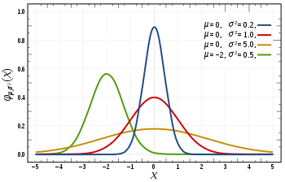
Overfitting Solutions – Increasing Sample Size
“If I just keep taking samples, surely I’ll eventually cover my whole sample space!”

Slide 111
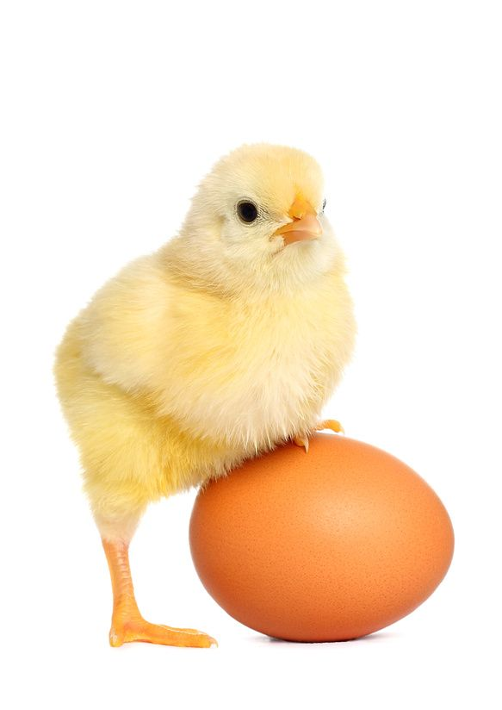
Overfitting Solutions – Targeted Sampling
“If I know to expect something, I can go seek out examples for training!”
 | Pos | Neg | Neg | Neg | Pos | ???
GPA | C | D | D | C | A | D
SAT | 1001-1400 | 751-1000 | 0-750 | 1001-1400 | 1401-1600 | 0-750
ACT | 21-25 | 11-15 | 16-20 | 21-25 | 31-36 | 21-25
Notes:
https://www.applicoinc.com/wp-content/uploads/2014/12/chicken-and-egg.jpg
https://cdn0.wideopenspaces.com/wp-content/uploads/2014/11/ftd-nimrodlion.jpg
https://cdn-images-1.medium.com/max/2600/1*9Z6W_yHevsq2jQZE9VK5rw.jpeg
https://i.redd.it/jc713jekk9901.jpg

Slide 112
Overfitting Solutions – Trust the Experts
Sometimes there could be databases or lists of interest to your problem, e.g. a “cutoff score” for SAT scores, or a “valence score” for NLP word connotations.
- Does it actually fit my problem space?
- Do I trust it?

Slide 113

Overfitting Solutions - Smoothing
Builds on the assumption that “nothing is impossible”
Notes:
https://media1.tenor.com/images/0a6182efc5ec93a6242b570f81394c0e/tenor.gif?itemid=11098164

Slide 114
Overfitting Solutions - Smoothing
Step 1) Start with a completely naïve, untrained understanding
- “a) All possible examples are equally likely to exist in my problem space and b) All classes are equally likely”
- All HS features are equally likely to appear in a student and all students are equally likely to be positive or negative
p(x) = 1 p(y) = 1
|V| |Y|

Slide 115
Overfitting Solutions - Smoothing
Step 2) Add our training cases to the evidence set
BEFORE
p(x|y) = p(x,y) = # positive grads with “x” in them
p(y) # positive grads
AFTER
p(x|y) = p(x,y) + 1 = # positive grads with “x” (found in training) + 1
p(y) +|V| # positive grads (in training) + tot. student options
Add-1 or Laplace Smoothing

Slide 116
Overfitting Solutions - Smoothing
Step 2) Add our training cases to the evidence set
BEFORE
p(y) = # positive students
# students
AFTER
p(y) = # positive students (found in training) + 1
# students (found in training) + total classes
Add-1 or Laplace Smoothing

Slide 117
Overcoming Data Problems
Binning + Smoothing
GPA: 5 Bins - A, B, C, D, F
SAT: 2 Bins - >600
ACT: 2 Bins - >25
 | Pos | Neg | Neg | Neg | Pos | ???
GPA | 2.5 | 1.9 | 1.2 | 2.1 | 4.0 | 1.2
SAT | 1100 | 990 | 750 | 1100 | 1600 | 550
ACT | 21 | 12 | 16 | 21 | 36 | 21

Slide 118
Smoothing Rationale
You are adding a unique case for each possible combination of features (including Outcome) to your observations, so that when you’re calculating how many of each case you observed, they include these hypotheticals, these “hallucinations”.
 | P | P | P | P | P | … | N | N | N | … | P | N | N | N | P | ?
GPA | A | B | … | A | B | … | A | B | C | … | C | D | D | C | A | D
SAT | + | + | … | - | - | … | + | + | + | … | + | + | + | + | + | -
ACT | L | L | … | L | L | … | L | L | L | … | L | L | L | L | H | L

Slide 119
Smoothing Rationale
 | P | P | P | P | P | … | N | N | N | … | P | N | N | N | P | ?
GPA | A | B | … | A | B | … | A | B | C | … | C | D | D | C | A | D
SAT | + | + | … | - | - | … | + | + | + | … | + | + | + | + | + | -
ACT | L | L | … | L | L | … | L | L | L | … | L | L | L | L | H | L
You are adding a unique case for each possible combination of features (including Outcome) to your observations, so that when you’re calculating how many of each case you observed, they include these hypotheticals, these “hallucinations”.
2 outcomes * 5 GPA bins * 2 SAT bins * 2 ACT bins = 40 new cases

Slide 120
Naïve Bayes - Probabilities
The probability of tweet x of length D being of class y
p(y|x) = p(y) * ∏_{i=1→D}(p(x_{i}|y))
We get some complicated, small numbers multiplication
- Theoretically valid
- We work with finite computing machines
- Leads to underflow
Let’s take the logarithm instead!

Slide 121
Naïve Bayes – Logarithms (ln)
Logarithm math refresher:
- ln(ab) = ln(a) + ln(b)
- ln(x) is monotonically increasing, so argmax() is still valid
y = argmax_{c} ln(p(c)) + ∑_{i=1→D}ln(p(x_{i}|c))

Slide 122
Exercise 2 – Naïve Bayes
Classifying Our Adult Dataset

